Slide 1
Modeling and Stimulus Control
Observational Learning therapeutic technique

Slide 2
Modeling and Stimulus Control
Dr Amina Muazzam

Slide 3
Introduction
The process of learning by watching others; a therapeutic technique used to effect behavioral change. The use of modeling in psychotherapy was influenced by the research of social learning theorist Albert Bandura, who studied observational learning in children, particularly in relation to aggression.

Slide 4
Definition
Modeling, which is also called observational learning or imitation, is a behaviorally based procedure that involves the use of live or symbolic models to demonstrate a particular behavior, thought, or attitude that a client may want to acquire or change. Modeling is sometimes called vicarious learning, because the client need not actually perform the behavior in order to learn it.

Slide 5
Purpose
Modeling therapy is based on social learning theory. This theory emphasizes the importance of learning from observing and imitating role models, and learning about rewards and punishments that follow behavior. The technique has been used to eliminate unwanted behaviors, reduce excessive fears, facilitate learning of social behaviors, and many more. Modeling may be used either to strengthen or to weaken previously learned behaviors.

Slide 6
Continue….
Several factors increase the effectiveness of modeling therapy in changing behaviors. Modeling effects have been shown to be more powerful when:
The model is highly skilled in enacting the behavior; is likable or admirable; is friendly; is the same sex and age; and is rewarded immediately for the performance of the particular behavior.
The target behavior is clearly demonstrated with very few unnecessary details; is presented from the least to the most difficult level of behavior; and several different models are used to perform the same behavior

Slide 7
Modelling Process
Attention
Stages of Modeling Process
Retention
Reproduction
Motivation
Reinforcement

Slide 8
5 Sages of Modeling Process
Attention –the Observer must actively watch the model when completing the task
Retention – the observer must be able to make a mental representation (step by step) of the model’s behavior.
Reproduction – the observer must have the ability to perform action.
Motivation – the learner must want to perform behavior. So if being taught something, then the counsellor should encourage the learner to repeat the behavior just seen.
Reinforcement – if the learner receives positive reinforcement, then this will increase the likelihood observer will repeat the behavior.

Slide 9
Types Of Modeling
Live Modeling
Symbolic Modeling
Participant Modeling
Covert Modeling
Role Playing

Slide 10
Continue…
Live Modeling - Live modeling refers to watching a real person, usually the therapist, perform the desired behavior the client has chosen to learn. For example, the therapist might model good telephone manners for a client who wants a job in a field that requires frequent telephone contact with customers.
Symbolic modeling – symbolic modeling includes filmed or videotaped models demonstrating the desired behavior.
participant modeling- In participant modeling the therapist models anxiety-evoking behaviors for the client, and then prompts the client to engage in the behavior. The client first watches as the therapist approaches the feared object, and then approaches the object in steps or stages with the therapist's encouragement and support. This type of modeling is often used in the treatment of specific phobias.

Slide 11
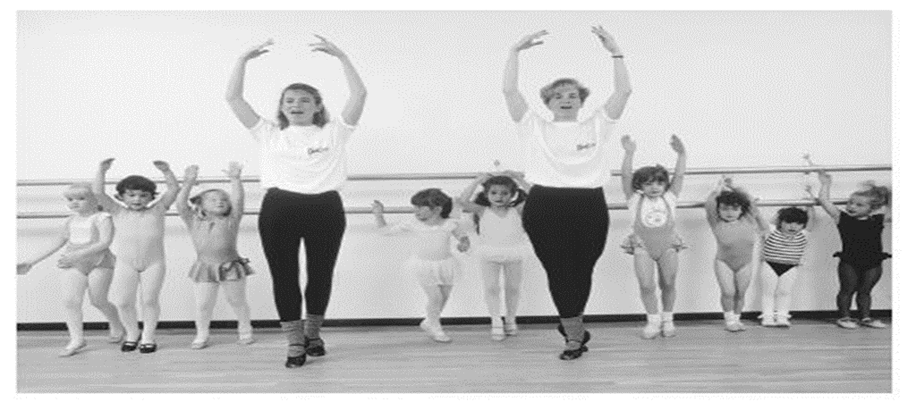
Young girls in a ballet dancing class. The instructors are serving as live models, showing the girls a behavior that they are to imitate and practice. This is an example of learning through modeling.
(Bob Krist/CORBIS. Photo reproduced by permission.)

Slide 12
Continue…..
Covert modeling - In covert modeling clients are asked to use their imagination, visualizing a particular behavior as the therapist describes the imaginary situation in detail.
Role-playing - Role-playing is a technique that allows the client opportunities to imitate the modeled behaviors, which strengthens what has been learned. Role-play can be defined as practice or behavior rehearsal.
Role-play can also be used for modeling, in that the therapist may role-play certain situations with clients. During practice, the therapist frequently coaches, prompts, and shapes the client's enactment of the behavior so that the rehearsals can come increasingly close to the desired behavior.

Slide 13
Stimulus Control
Stimulus control is a method of reducing negative or maladaptive behaviors based on the principals of respondents (or classical conditioning) learning. Briefly, by conceptualizing on the conditioning relationship between a stimulus and a response and modifying the stimulus, it is possible to break the stimulus response relationship.
Stimulus control can be used to modify many health behaviors. For example, stimulus control can be used to treat insomnia. Normally, a bed is unconditionally connected to sleep. However, for insomnia, the bed often becomes associated with wakefulness. This generally occurs through the pairing of bed (the unconditioned stimulus) with other ”awake” behaviors like reading, watching television, or working on the computer. Thus, bed becomes conditionally connected to wakefulness. Stimulus control would be useful to break the connection between bed and other behaviors.
Stimulus control can also be used to modify dieting behavior. As with nicotine eliciting craving for more cigarettes, food can elicit craving for more food. Often, eating is paired with other conditioned stimuli such as certain times of day, certain groups of people, and certain settings

Slide 14
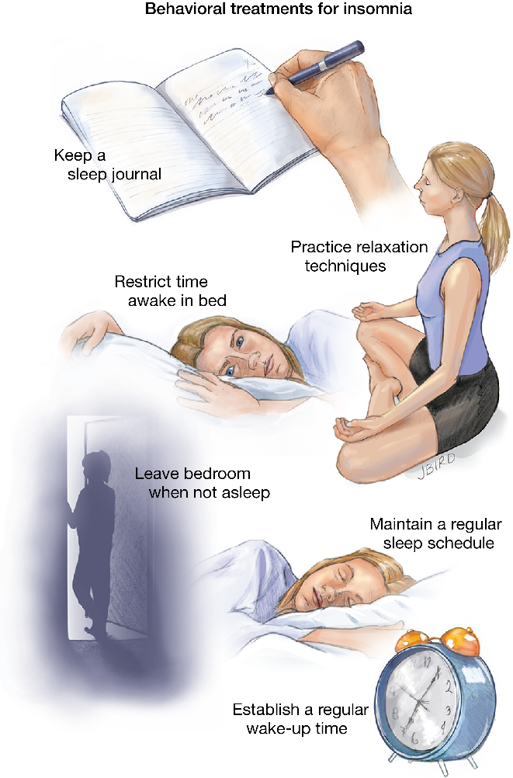
Stimulus Control treatment of Insomnia

